Slide 1

DEJA VU: CONTINUAL MODEL GENERALIZATION FOR UNSEEN DOMAINS cs 771
Krishanu ray
KUSHAGRA SRIVASTAVA
SUVAM MUKHOPADHYAY
RITIKA KUMARI
SHUBHASHISH SHUKLA

Slide 2
introduction
Deep learning models in real-world, non-stationary environments face challenges from shifting data distributions. Domain Adaptation (DA) methods struggle during early adaptation, while Domain Generalization (DG) methods suffer from catastrophic forgetting in continually changing domains.
The paper proposes RaTP, a framework addressing these issues by improving Target Domain Generalization (TDG), enabling fast Target Domain Adaptation (TDA), and ensuring Forgetting Alleviation (FA). RaTP incorporates training-free data augmentation, pseudo-labeling for reliable adaptation, and prototype contrastive alignment for domain alignment. It achieves state-of-the-art performance across benchmarks like Digits, PACS, and DomainNet.

Slide 3
DOMAIN ADAPTATION (DA) METHODS
Domain Adaptation (DA) methods address continual data drifts in dynamic environments, but practical limitations arise:
Continual DA adapts models to new domains while maintaining performance on seen domains but assumes constant access to source data, which is often impractical due to privacy, memory, or IP constraints.
Source-Free DA enables adaptation without source data but has limited flexibility.
Test-Time/Online DA improves performance with minimal training costs but struggles with significant improvements due to limited target data.
These methods often fail in the Unfamiliar Period (before or during adaptation), performing poorly under sudden domain shifts or limited exposure to new domains. Ensuring reasonable performance in this critical period is vital for applications like environmental surveillance or medical imaging, where delays can lead to safety or health risks.

Slide 4
Domain Generalization (DG) methods
Domain Generalization (DG) methods aim to enable models to generalize across multiple domains, even when the target domain is unknown during training. While effective in static settings, they face significant challenges in dynamic and continually changing environments:
Dependence on Accurate Supervision: DG methods rely heavily on accurate labels or supervision from the source domain data, whether it comes from a single domain (Wang et al., 2021c; Li et al., 2021 ;Yao et al., 2022; Zhang et al., 2022). This assumption breaks down in scenarios with limited or noisy labeled data, which is common in real-world, dynamic settings.
Catastrophic Forgetting in Continual Shifts: When DG methods are applied in settings with continual domain shifts, they often focus on generalizing to the latest domain at the cost of forgetting previously learned domains, leading to degraded overall performance.
Unified DA-DG Approaches: Some works (Ghifary et al., 2016; Motiian et al., 2017; Jin et al., 2021) attempt to combine Domain Adaptation (DA) and DG. However, these methods are limited to either standard DA or DG scenarios and fail to address dynamic, continually evolving domains.
Inability to Handle Large Domain Shifts: Techniques designed for smooth, gradual shifts in data distributions (e.g., Bai et al., 2022; Nasery et al., 2021) are ineffective when facing sudden and significant domain changes over time, which are common in many real-world applications.

Slide 5
PROPOSED APPROACH
The proposed work addresses the Continual Domain Shift Learning (CDSL) problem, where a model is trained on a labeled source domain and continually encounters a series of unlabeled target domains. Our primary focus is improving model performance during the Unfamiliar Period (before and during training on a new target domain) while ensuring strong performance afterward.
We propose RaTP, a framework that optimizes three key objectives:
Target Domain Generalization (TDG): Enhancing model performance on new domains before and during training. Achieved using a training-free data augmentation module based on Random Mixup to generate diverse data outside the current domain.
Target Domain Adaptation (TDA): Ensuring high performance immediately after training on a target domain. Utilizes a Top2 Pseudo-Labeling mechanism, emphasizing accurate classification of confident samples.
Forgetting Alleviation (FA): Maintaining performance on previously trained domains after adapting to new ones. Enabled by a Prototype Contrastive Alignment algorithm to optimize TDG, TDA, and FA concurrently.
Extensive experiments on Digits, PACS, and DomainNet demonstrate that RaTP outperforms state-of-the-art methods in TDG while achieving comparable performance in TDA and FA across various DA and DG benchmarks.

Slide 6
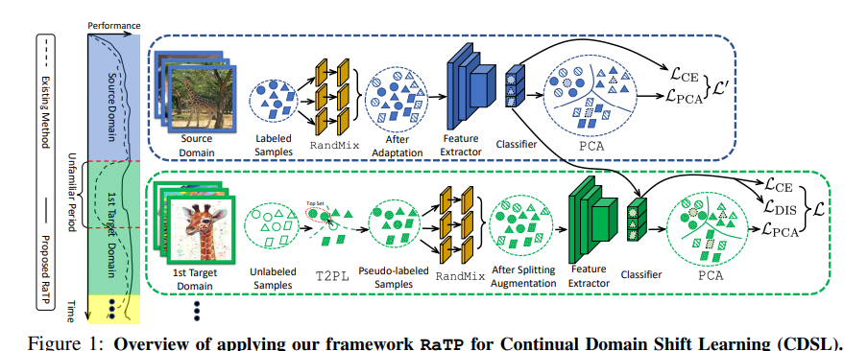
OVERVIEW OF CDSL

Slide 7
Problem Formulation: Continual Domain Shift Learning
Setup:
Start with a labeled source domain S:
Domains arrive continually and in random order, requiring the model to adapt dynamically.
Challenges:
Memory constraints: Limited exemplar memory MMM to store representative samples due to privacy, storage, or IP limitations.
Dynamic adaptation: Maintain performance across domains despite continual shifts and unseen target data.
Model Structure:
A deep neural network with a feature extractor fθ​​ and a classifier gω​.
Each new model builds on the previous domain's version to handle continual learning.
Objectives:
Target Domain Generalization (TDG): Perform well during the Unfamiliar Period (before/during training on new domains).
Target Domain Adaptation (TDA): Achieve strong performance immediately after training.
Forgetting Alleviation (FA): Retain performance on previously trained domains.

Slide 8
RANDOM MIXUP AUGMENTATION
In Continual Domain Shift Learning (CDSL), where a model must adapt from a labeled source domain to unseen target domains, RandMix improves generalization by generating augmentation data.
Autoencoder-based approach: Utilizes simple autoencoders (with randomly initialized parameters) to generate augmented data without requiring training.
Noise injection (AdaIN): Injects controlled noise to improve generalization and prevent overfitting.
Random Mixup: Combines augmented data with original source data using random weights and a sigmoid function for normalization.
Selective target domain augmentation: For the target domains, RandMix augments only high-confidence samples to avoid error propagation.
This method enhances cross-domain transferability and helps maintain robust performance across dynamic domains in CDSL.

Slide 9
TOP2 PSEUDO LABELING
In Continual Domain Shift Learning (CDSL), target domains arrive with unlabeled data, necessitating accurate pseudo-labeling for model supervision. Top2 Pseudo Labeling (T2PL) addresses limitations in traditional pseudo-labeling methods by improving classification accuracy and handling overlapping classes.
Softmax Confidence: T2PL uses softmax confidence to select the top 50% of high-confidence samples for constructing class centroids.
Centroid Construction: It aggregates selected samples based on prediction confidence to build class centroids.
k-Nearest Neighbor (kNN): A kNN classifier is applied to the selected top samples to assign accurate pseudo labels, reducing the risk of misclassification.
Improved Accuracy: T2PL avoids errors from clustering-based methods by focusing on high-confidence samples, providing more reliable pseudo-labels for training.
This approach ensures more accurate supervision for the model in continually shifting domains, leading to better performance during the Unfamiliar Period in CDSL.

Slide 10
PROTOTYPE CONTRASTIVE ALIGNMENT(PCA)
Regular Prototype Learning (PL) faces challenges in cross-domain alignment, especially due to adaptivity gaps and sample insufficiency.
The proposed Prototype Contrastive Alignment (PCA) algorithm improves upon regular PL by addressing these issues.
Adaptivity Gap in Regular PL: Traditional PL aggregates and averages prototypes across domains, leading to alignment problems, particularly when prototypes from different domains are far from the optimal class prototype.
Proposed Solution: PCA introduces linear layer prototypes (based on the classifier's neuron weights) for better cross-domain alignment. These prototypes are optimized through contrastive learning, which improves the distinction between classes and addresses the adaptivity gap.
Use of RandMix: The RandMix data augmentation is integrated into the training process to generate more diverse data, helping the model improve generalization and reduce the adaptivity gap during training.Contrastive Alignment: Instead of averaging domain prototypes.This approach provides more representative prototypes and better domain alignment, leading to improved generalization performance across continually shifting domains.

Slide 11
EXPERIMENTS
Datasets:
Digits: 5 domains (MNIST, SVHN, MNIST-M, SYN-D, USPS) with 10 classes.
PACS: 4 domains (Photo, Art, Cartoon, Sketch) with 7 classes.
DomainNet: 6 challenging domains (Quickdraw, Clipart, Painting, Infograph, Sketch, Real).
Experiment Settings:
Feature Extractors: ResNet-50 for PACS and DomainNet; DTN for Digits.
Data Split: 80% for training and 20% for testing in the source domain; all data used in target domains.
Optimization: SGD optimizer, learning rate of 0.01 (Digits), 0.005 (PACS, DomainNet), batch size of 64.
Exemplar Memory Size: Set to 200 for all datasets.
Multiple Runs: Average performance reported from three seeds (2022, 2023, 2024)

Slide 12
CONCLUSION
This paper presents RaTP, a framework designed to enhance model performance during the Unfamiliar Period—the phase before and during the training of new, continually arriving domains.
RaTP consists of:
RandMix: A training-free data augmentation module.
T2PL: A pseudo labeling mechanism.
PCA: A prototype contrastive alignment training algorithm.
Extensive experiments show that RaTP significantly improves performance in the Unfamiliar Period and outperforms state-of-the-art methods in Target Domain Adaptation (TDA), Forgetting Alleviation (FA), and across various DA and DG settings.

Slide 13
Thank you

